Slide 1



Tech Loyalties
User Interface Design Presentation

Slide 2
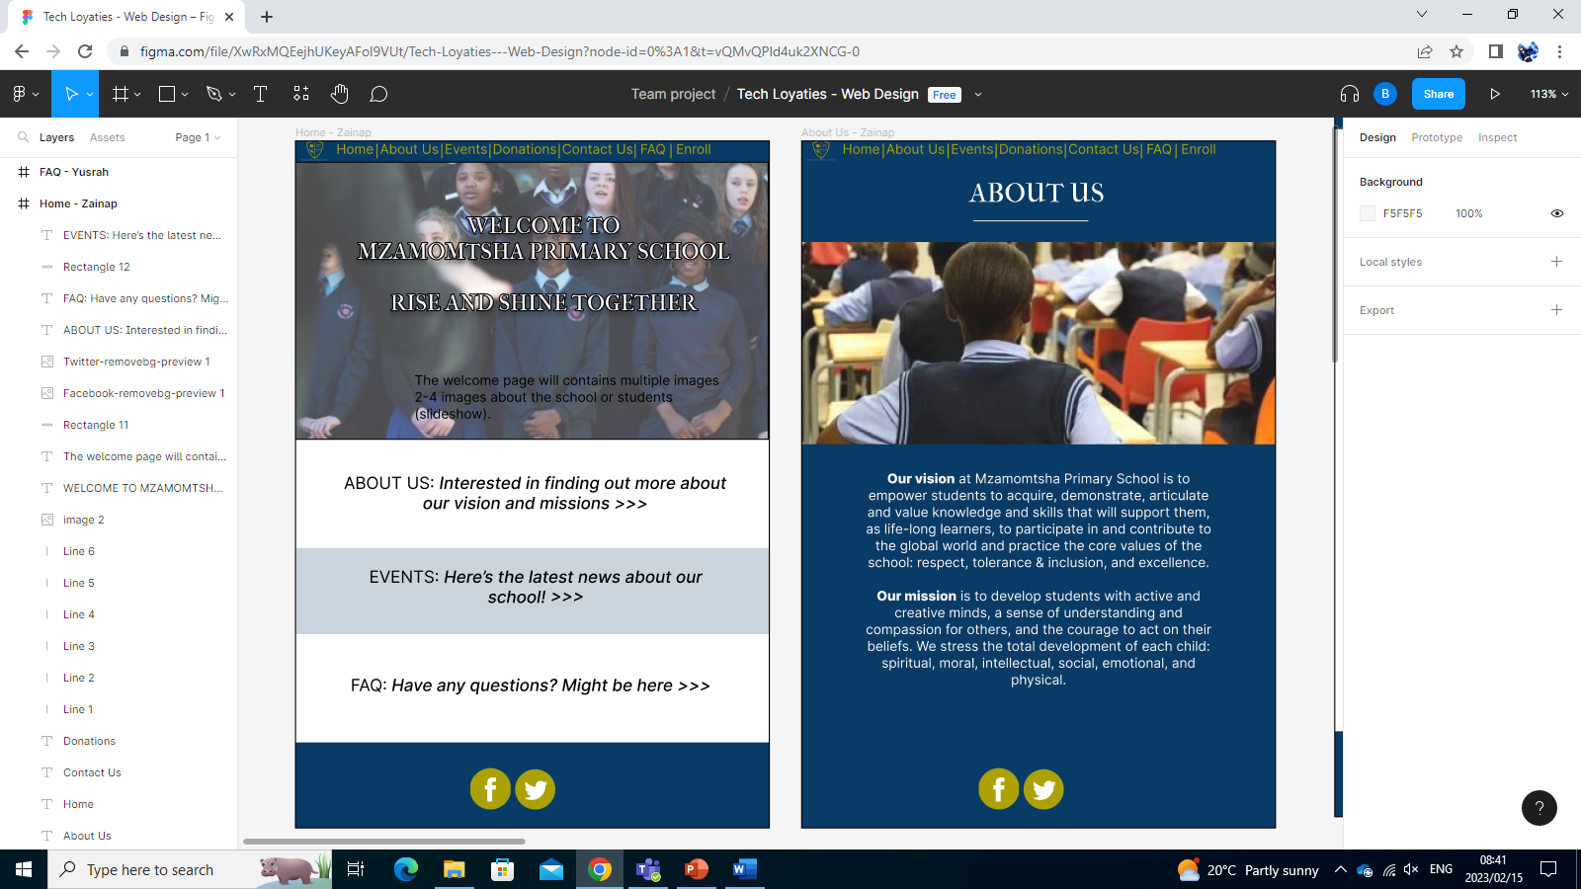
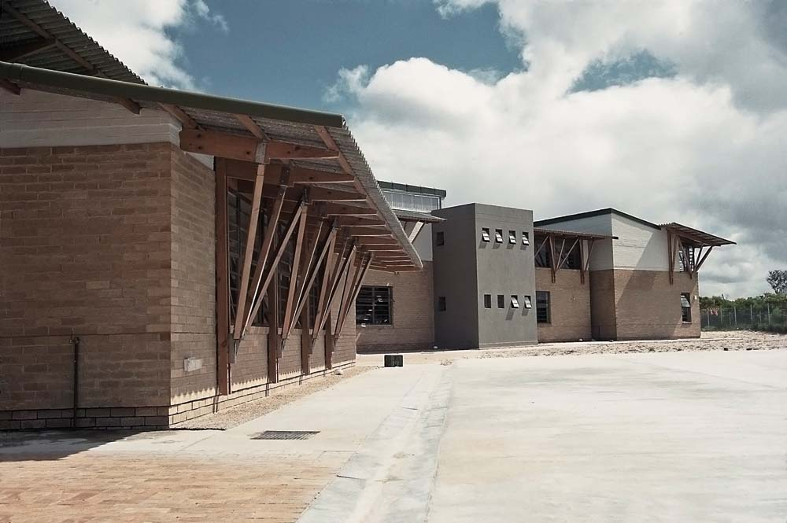
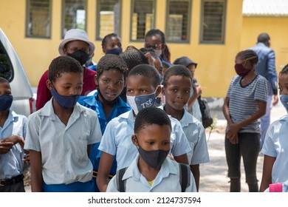
Home Page
About Us

Slide 3
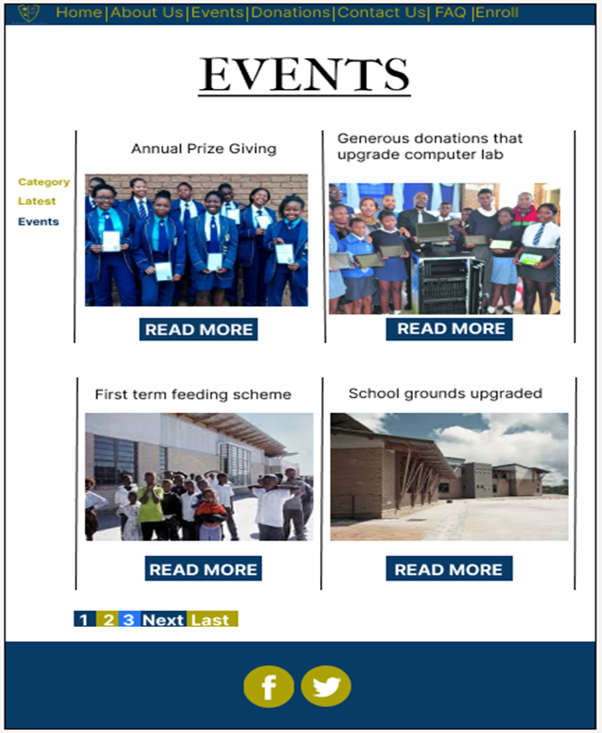
Events Page
Navigation Bar
Current Events
This particular page depicts the planned and organized occasion that take place at Mzamomtsha Primary School within an academic calendar year.
By clicking on the event’s, the web browser will show the most recent, past & future events.
Since the school is in its developing phase there isn’t much to account for, however we managed to get the most informative events that have occurred so far, specifically the annual prize giving, upgrading of computer lab, feeding scheme as well as the school grounds upgrade.
Pages
Footer

Slide 4
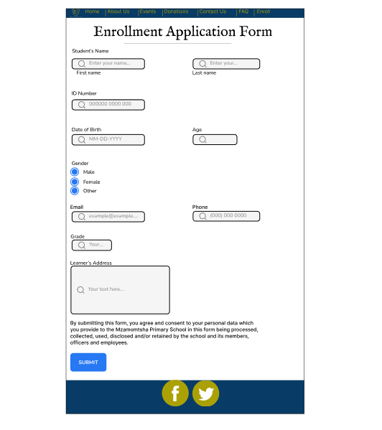
Enrollment Page
After clicking on the navigation bar 'Enroll' button from the home page you get redirected to this page.
This page allows learners that want to enroll at Mzamomtsha to apply.
Allows staff members to identify which applicants are the best fit for the school by comparing all candidates' information.
Having this page allows the school to save time and costs, allows for accurate and real-time tracking.
Staff members can make the right admission decisions in a timely manner.
It provides clear instructions as to what are the exact details that are needed from an applicant.
This page is to help admission teams ultimately enroll more learners.

Slide 5
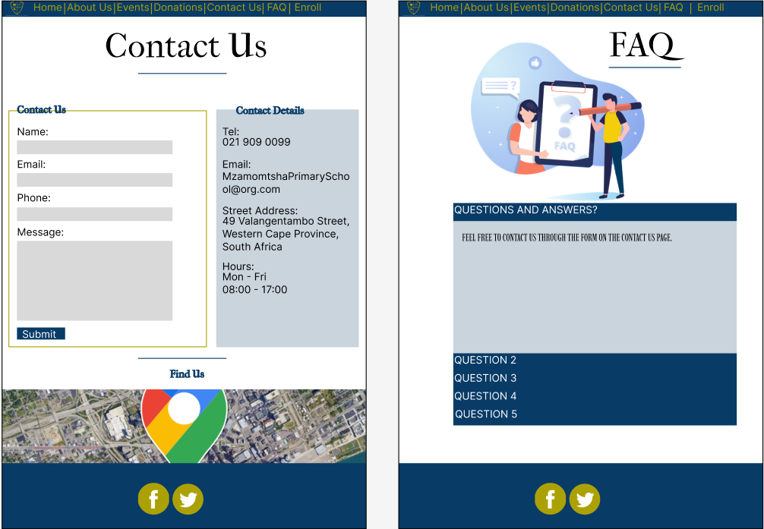
Contact Us
FAQ
Gold Accent
Query form
Contact details
Q & A collapsible panels
Map
Light Navy Blue Highlights

Slide 6
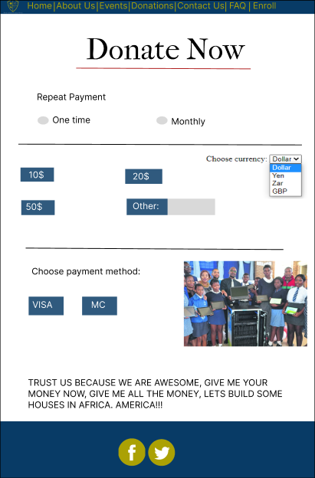
Important Notes:
This is not a standalone webpage but rather a pop out page.
The payments can be set to repeat or once off.
The user can select the currency they wish to make the payment in
The payment processing will not be done by us but by more reliable companies like Visa Electron.

Slide 7

Thank You!
Any Questions?

